Slide 1
Snapshot SNAFU: Preventative Measures to Safeguard Deliveries
Spencer Childress
Alex Buck

Slide 2
Outline
Rationale
%SnapshotCompare
Parameters and directory setups
Metadata comparisons
Dataset level
Variable level
ID level
Email
Summary

Slide 3
Rationale
Evidence of database progression
More observations per dataset
Confirmation of dataset integrity
Same number of variables with unchanged attributes
Easily digested report of snapshot metadata comparisons
Notes:
Data transfers, did they happen?
The data is there, so why is my program crashing? (How variables can change)
A drop in AEs/PDs/Conmeds, and anything else that shouldn’t decrease
When do you find the issue and how bad it is to find it later?

Slide 4
%SnapshotCompare
Compiles and compares the metadata of two snapshots
Generates and emails a report
%SnapshotCompare(Path1 = ,
Emails = ,
Path2 = ,
IDVar = ID,
Detail = ALL,
Project = );
Required
Optional

Slide 5
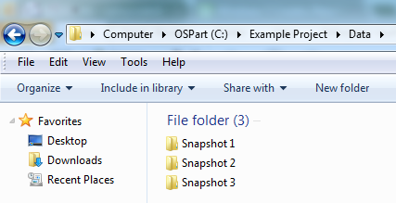
Folder Structure Example 1
Each snapshot lives in its own folder below \Data
%SnapshotCompare(Path1 = C:\Example Project\Data,
Emails = jane_doe@email.com);

Slide 6
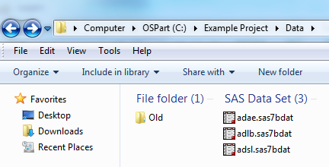
Folder Structure Example 2
Current snapshot lives in \Data and old snapshots live in \Data\Old
%SnapshotCompare(Path1 = C:\Example Project\Data,
Emails = john_doe@email.com,
Path2 = Old);

Slide 7
Metadata Comparisons
Relevant metadata at each level of a database
Many ways to capture and compare metadata
Captured mostly with PROC SQL
Compared in the data step
Present each metadata comparison by dataset
Traffic light potential issues
Everything begins with two LIBNAME statements, one for each snapshot…

Slide 8
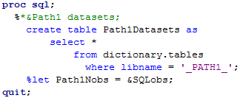

Dataset-level Comparison
Relevant metadata
existence
observation count
variable count
size
creation date
modification date
PROC SQL DICTIONARY.TABLES
Data step external file functions

Slide 9
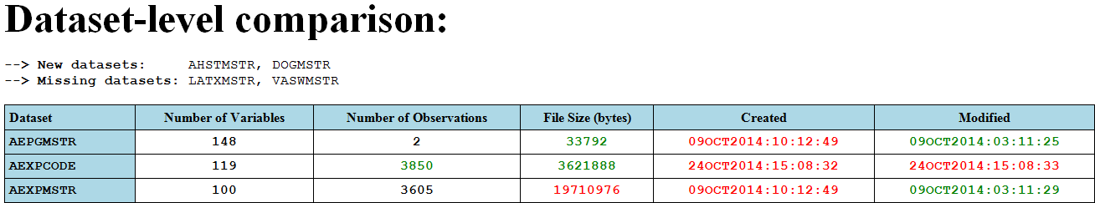
Dataset-level Report
List of new and/or missing datasets
Table with one row per dataset and one column per attribute
Traffic lighting: expected changes, no change, and unexpected changes.

Slide 10
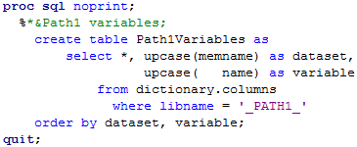
Variable-level Comparison
Relevant metadata
existence
type
format
informat
label
length
PROC SQL DICTIONARY.COLUMNS

Slide 11
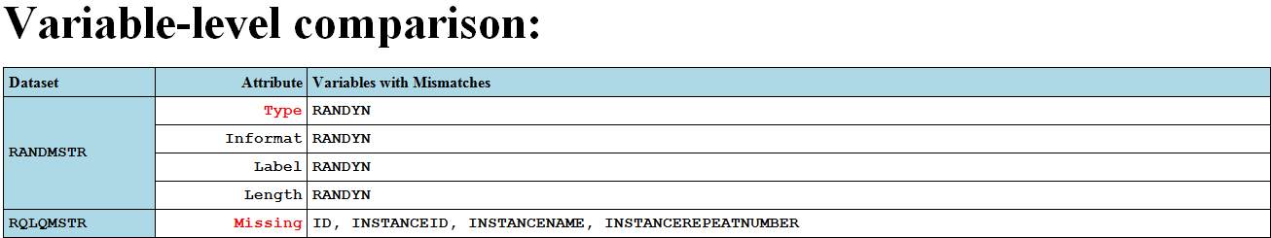
Variable-level Report
Table with one row per dataset per attribute, an attribute column, and a variable list column
Traffic lighting: more significant attributes and less significant attributes

Slide 12
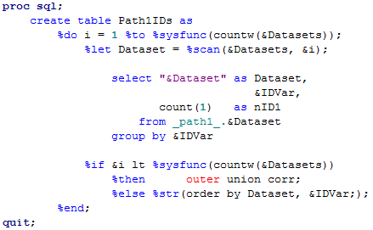
ID-level Comparison
Relevant metadata
new IDs
missing IDs
IDs with fewer records
PROC SQL COUNT() + OUTER UNION CORR
One record per dataset per ID
Cycle through datasets
Stack datasets
Count number of observations per ID

Slide 13
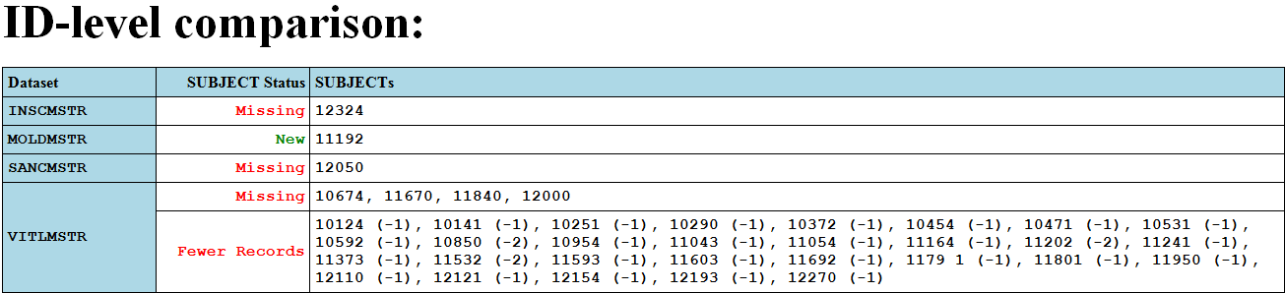
ID-level Report
Table with one row per dataset per status, a status column, and an ID list column
Traffic lighting: missing IDs, IDs with fewer records, and new IDs

Slide 14

Email
Assign a filref with the FILENAME statement and the EMAIL access method
Print comparisons to the fileref, just like to an ODS destination or the Output window
In this case everything prints from the data step, including:
A time-dependent greeting
Hyperlinks to the locations of the snapshots
The dataset-, variable-, and ID-level reports

Slide 15
Summary
Final emailed report contains three primary steps
Assign LIBNAMES to each snapshot
Compare metadata at the:
Dataset level
Variable level
ID level
Print metadata comparisons to an email
Intermediate steps
Check input argument, produce message in log
Generate hyperlinks to local and network drives
Customize report

Slide 16
Conclusion
Widespread use of this macro will provide a sense of integrity in a snapshot and avoid time consuming re-work later down the line
Macro can be run manually or a command file can be created to run the macro as a scheduled task.
Recommended reading
http://www.w3schools.com/html/
http://www.regular-expressions.info/

Slide 17

Thank You – Questions/Comments?

